Slide 1
Clipping and Comparator Circuits
Muhaimin Bin Munir

Slide 2
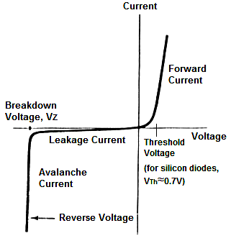
Diode
Threshold Voltage - This is the voltage which must be supplied to the diode for it to conduct any considerable forward current.
Forward Current - The current flowing through the diode in the direction of lower resistance
Breakdown Voltage - This is the reverse voltage that when applied to the diode will cause the diode junctions to break down and conduct a large amount of current, even though the voltage is applied with incorrect polarity.
Reverse (leakage) Current - A conventional diode will conduct some current even when reverse voltage is applied.

Slide 3
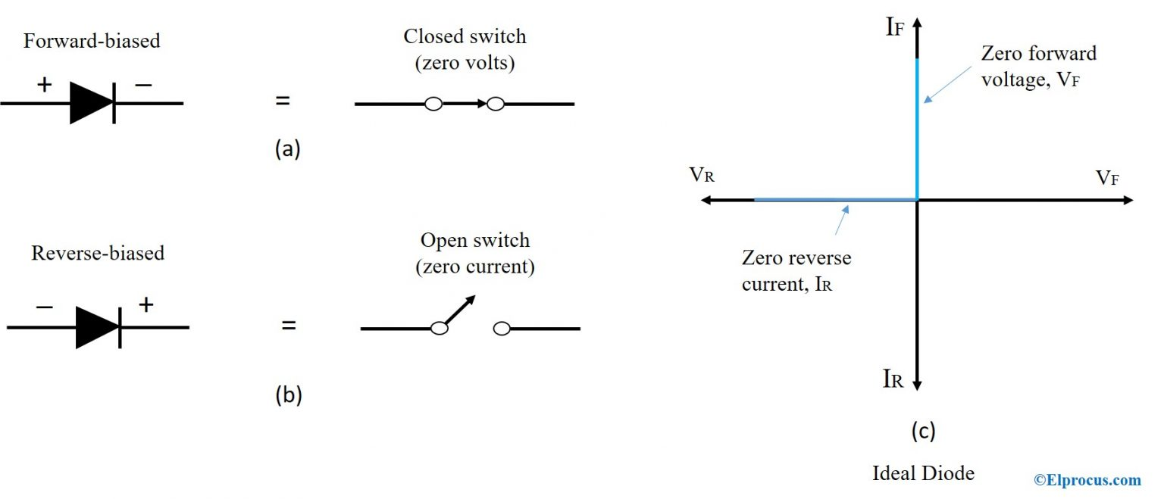
Diode Approximation
First Approximation
Diode approximation is a mathematical method used to approximate the nonlinear behavior of real diodes to enable calculations and circuit analysis.
In the first approximation method, the diode is considered as a forward-biased diode and as a closed switch with zero voltage drop.

Slide 4
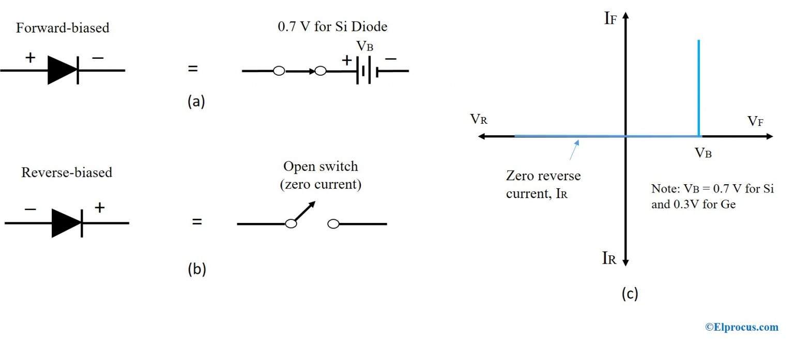
Diode Approximation
Second Approximation
In the second approximation, the diode is considered as a forward-biased diode in series with a battery to turn on the device.

Slide 5
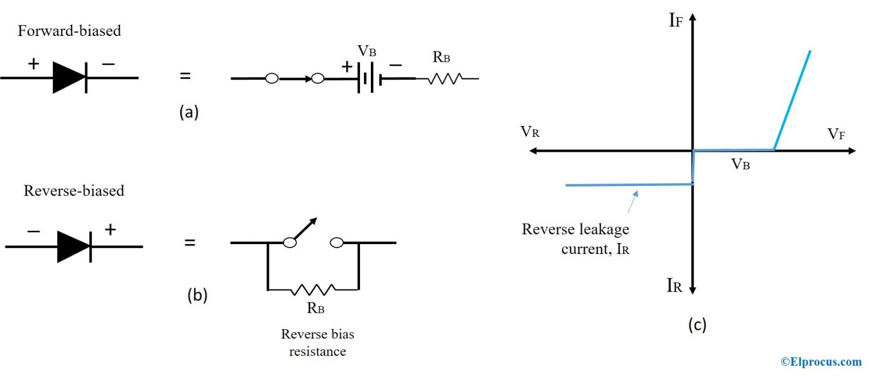
Diode Approximation
Third Approximation
The third approximation of a diode includes voltage across the diode and voltage across bulk resistance, R_{B}. The bulk resistance, R_{B} corresponds to the resistance of p and n materials. This resistance changes based on the amount of forwarding voltage and the current flowing through the diode at any given time.

Slide 6
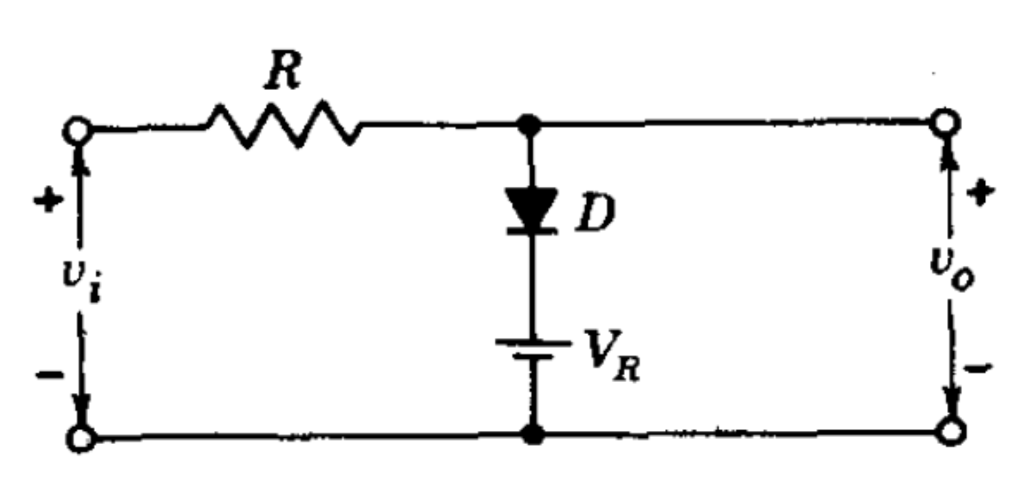
Diode Clippers

Slide 7
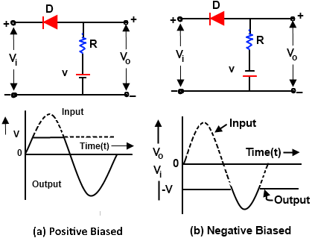
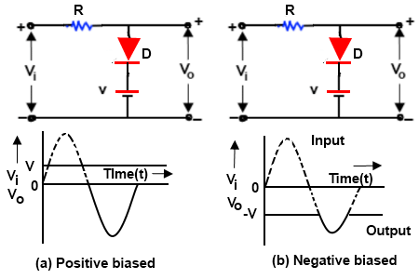
Diode Clippers
Clipper Classification
The Diode Clipper, aka a Diode Limiter, is a wave shaping circuit that takes an input waveform and clips or cuts off its top half, bottom half or both halves together.
Series Clipper Circuit Parallel/Shunt Clipper Circuit

Slide 8
Clippers Application
They are frequently used for the separation of synchronizing signals from the composite picture signals.
The excessive noise spikes above a certain level can be limited or clipped in FM transmitters by using the series clippers.
For the generation of new waveforms or shaping the existing waveform, clippers are used.
The typical application of diode clipper is for the protection of transistor from transients, as a freewheeling diode connected in parallel across the inductive load.
Frequently used half wave rectifier in power supply kits is a typical example of a clipper. It clips either positive or negative half wave of the input.
Clippers can be used as voltage limiters and amplitude selectors.

Slide 9
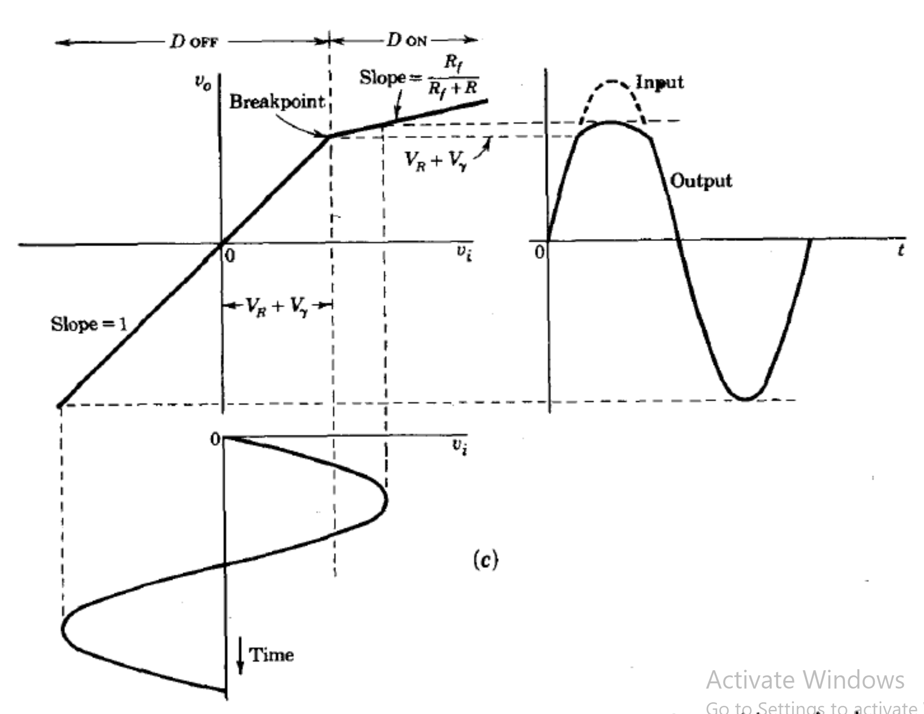

Slide 10
V_{i} = I (R + R_{f})
V_{o} = IR_{f}
V_{o}/ V_{i} = R_{f} / (R + R_{f}) V_{o} = R_{f} / (R + R_{f}) x V_{i}

Slide 11
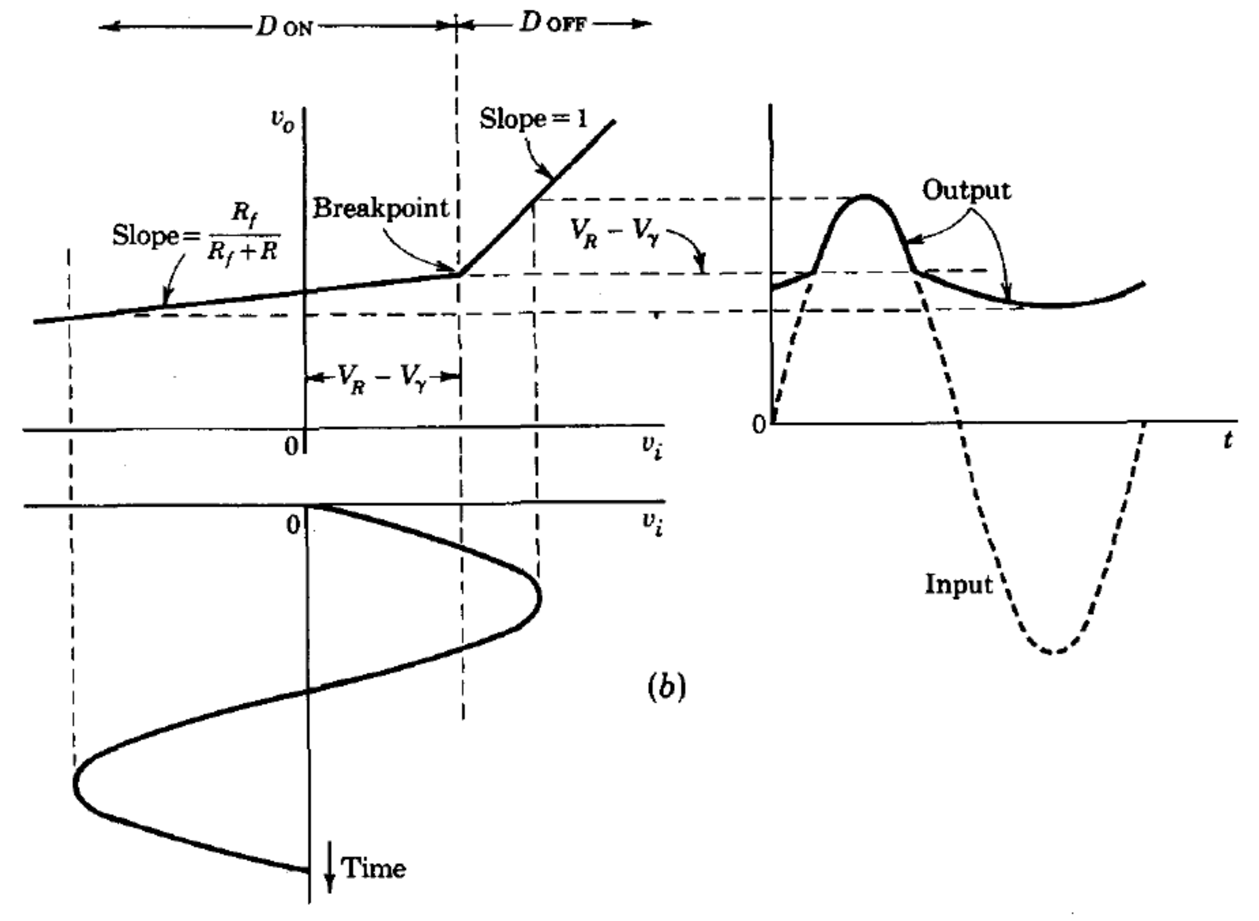
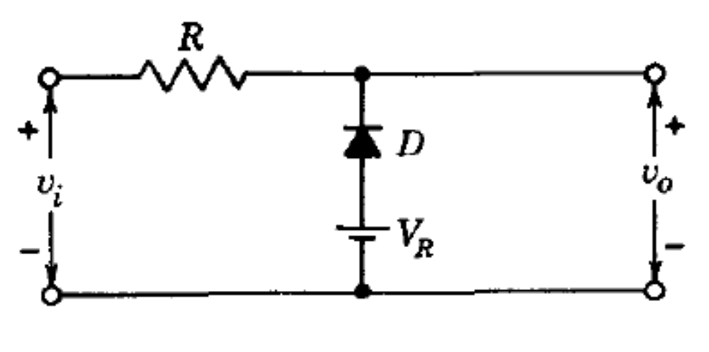

Slide 12
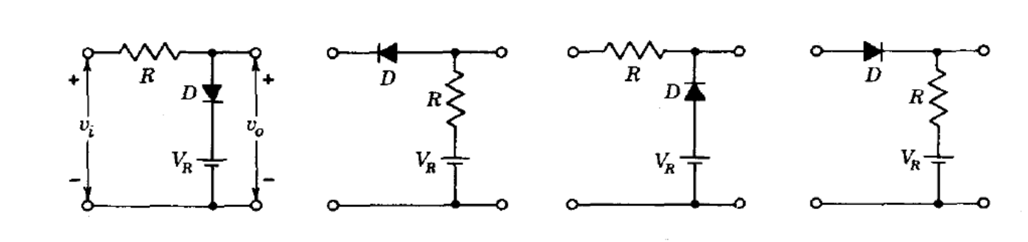
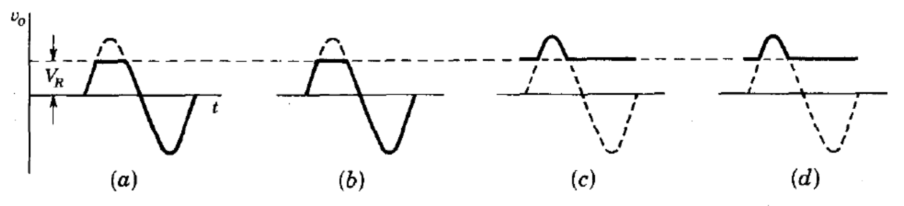
V_{i} < V_{r} -- Diode on -- V_{o} = V_{i} V_{i} ≥ V_{r} -- Diode off -- V_{o} = V_{r}
V_{i} ≥ V_{r} -- Diode on -- V_{o} = V_{i} V_{i} < V_{r} -- Diode off -- V_{o} = V_{r}

Slide 13
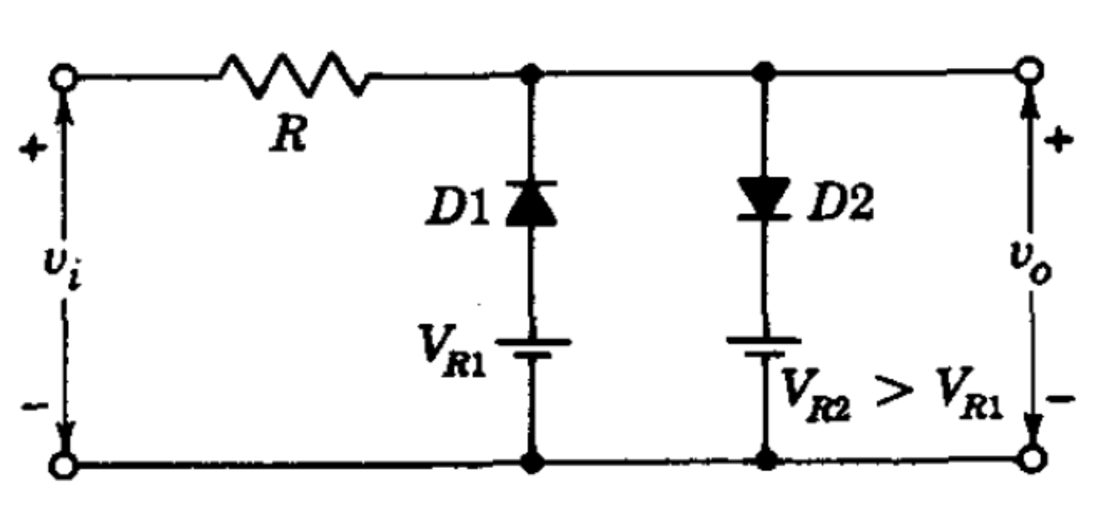
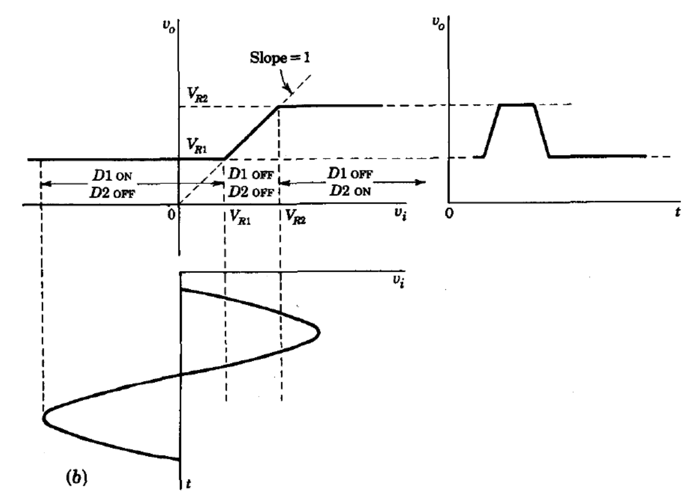
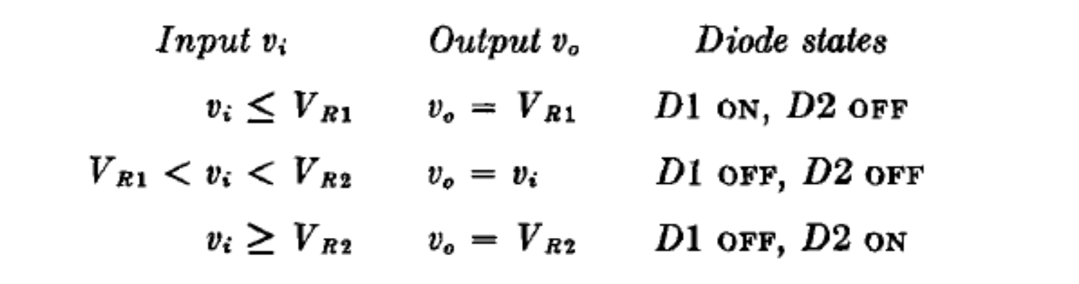

Slide 14
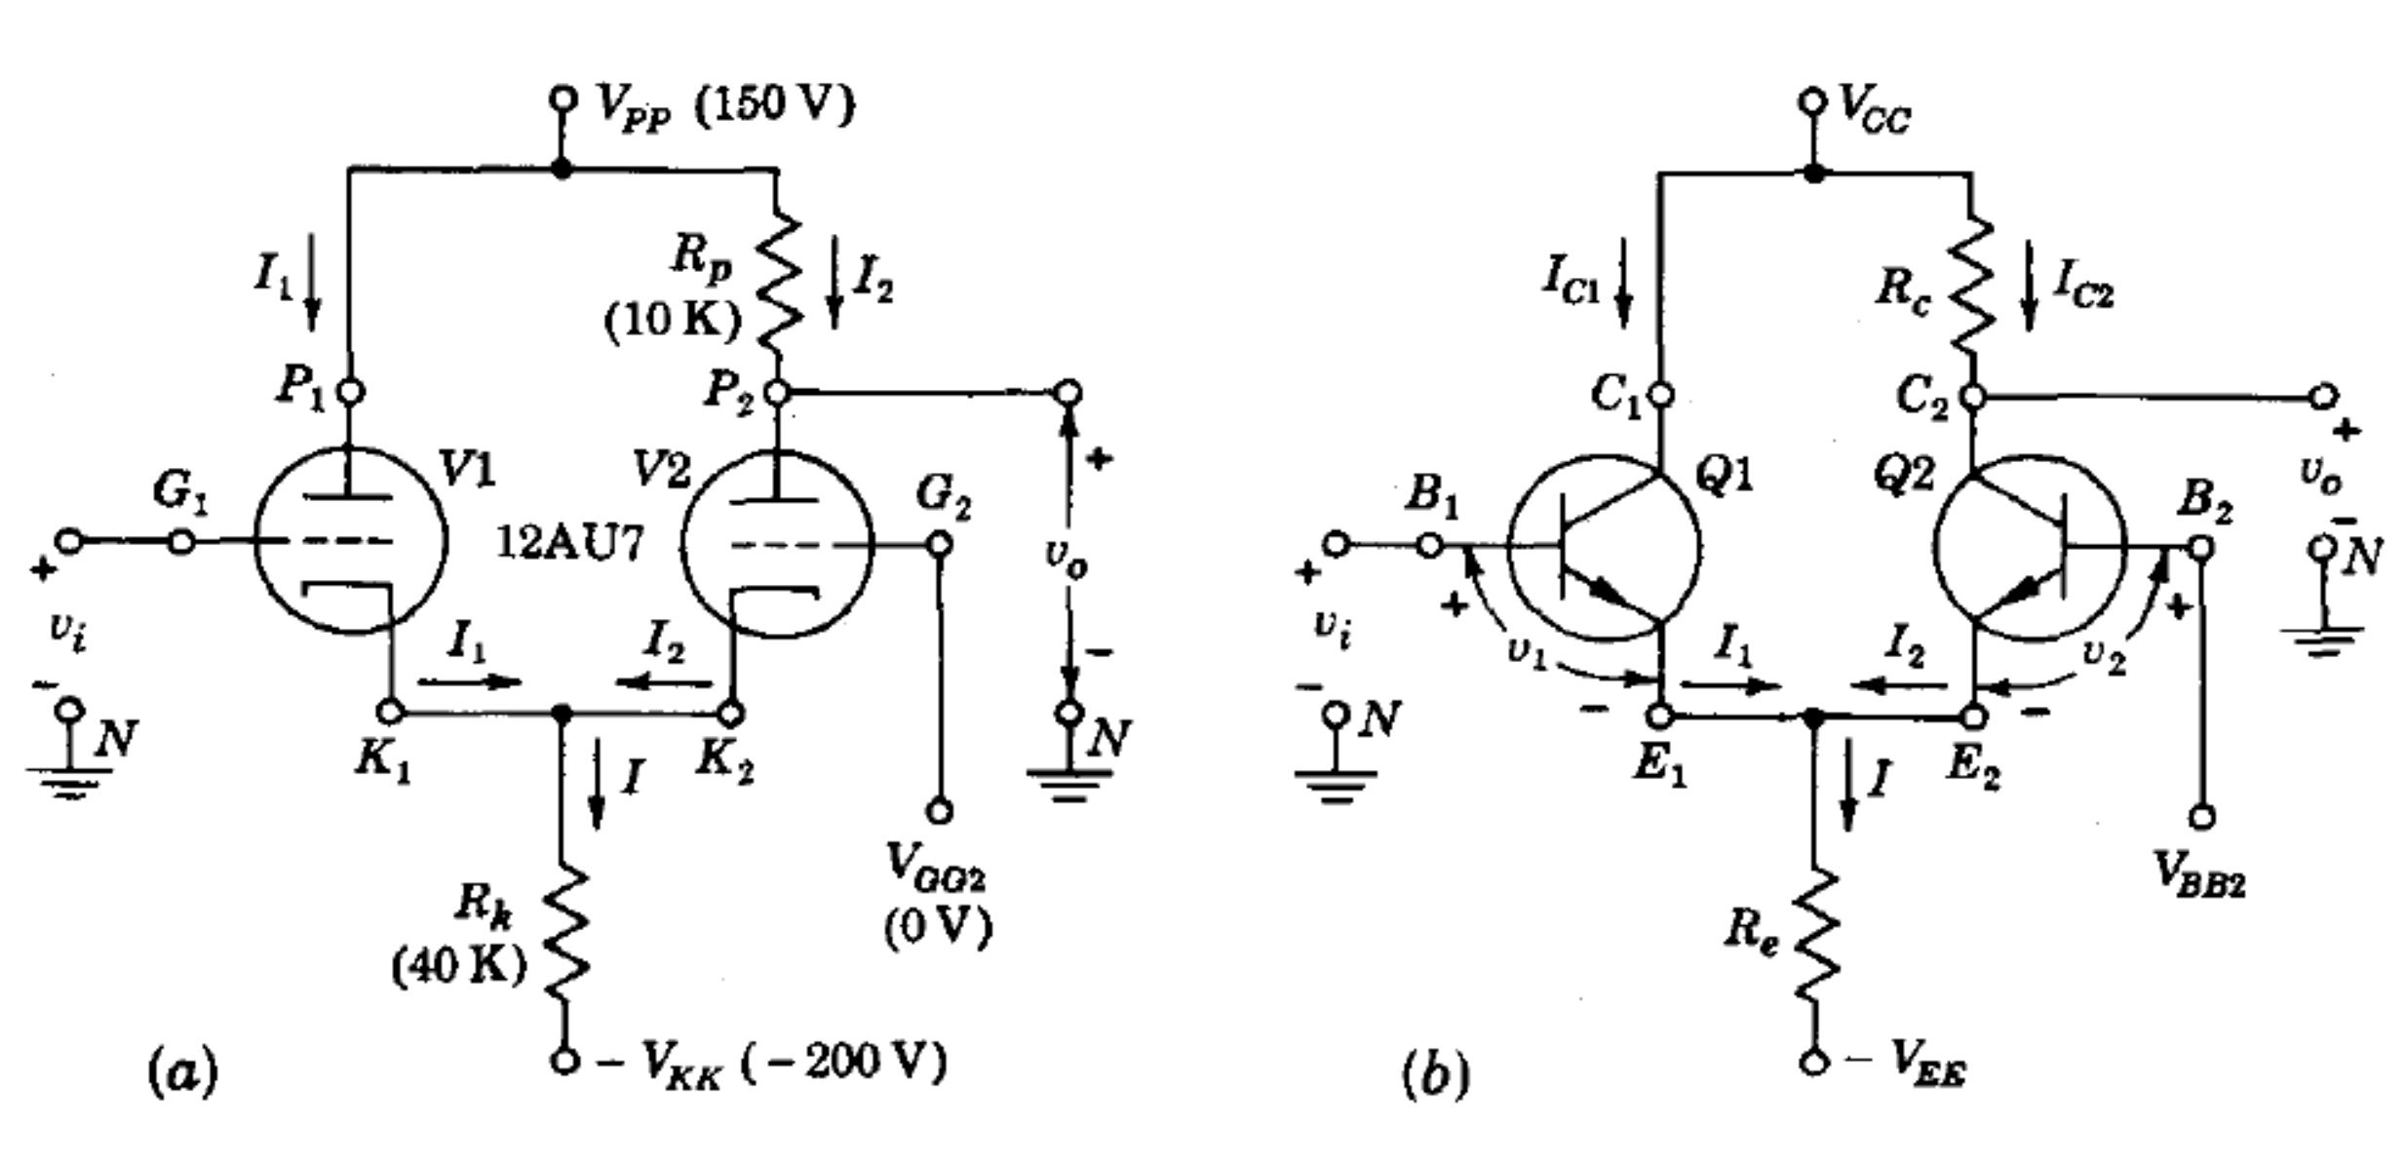
Transistor Clippers

Slide 15
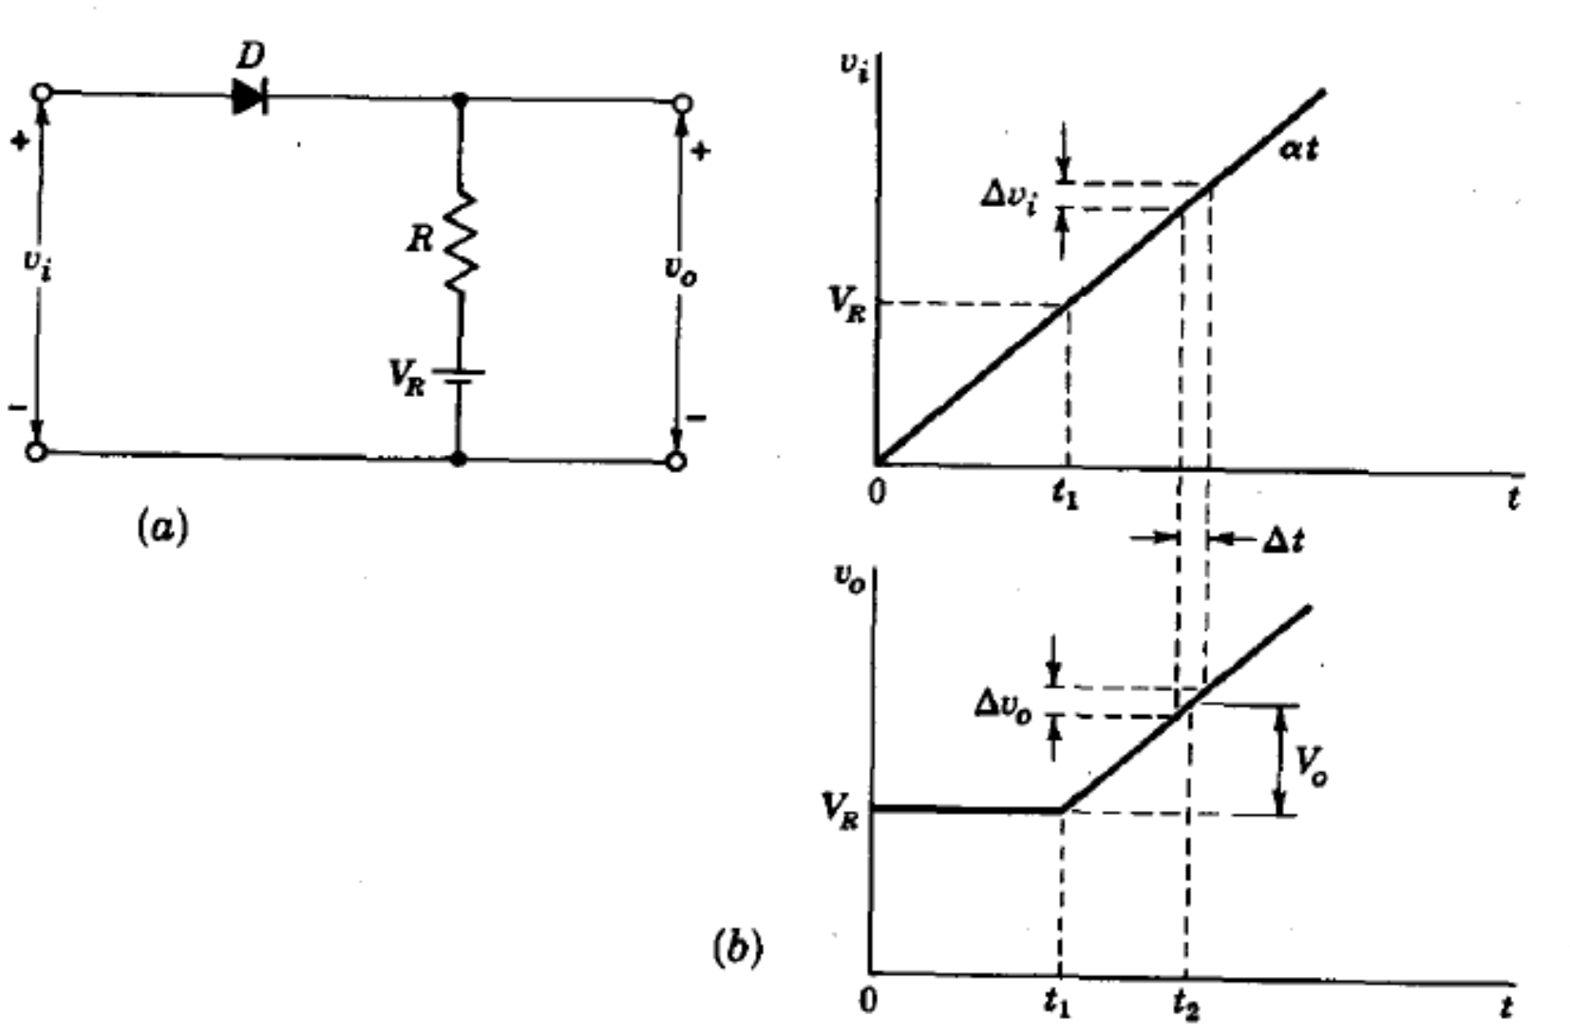
Comparators(Slide 275)
A comparator circuit is one which may be used to mark the instant when an arbitrary waveform attains some reference level.

Slide 16
Application of Voltage Comparators
Please Refer to section 7.16 of the Book Pulse and Digital Switching Waveforms

Slide 17
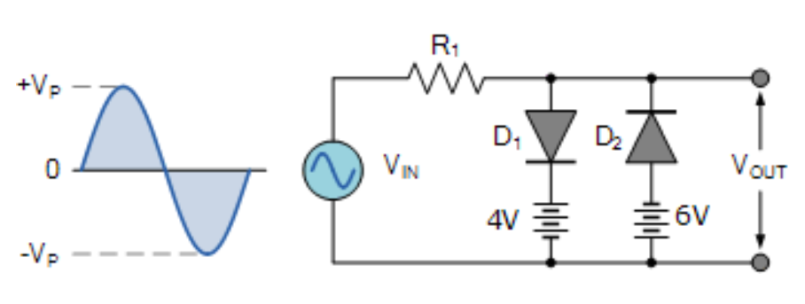
Study
And Similar circuits….
Find different clipping circuits here

Slide 18
Reference
https://www.elprocus.com/types-of-clipper-and-clamper-circuits-and-applications/#:~:text=Applications%20of%20Clippers%20and%20Clampers&text=They%20are%20frequently%20used%20for,by%20using%20the%20series%20clippers
https://www.youtube.com/watch?v=S76CnEJMl5E&t=168s
Pulse and Digital Switching WaveForms - Millman and Taub
https://www.youtube.com/watch?v=vXdIGCicVbA
https://www.circuitstoday.com/diode-clippers

Slide 19
“If people supply you negative voltage, be a Zenner Diode”

